Slide 1


PIGGY-PON
Presented By: KZH

Slide 2
PIGGY-PON
Contents
Motivation - The WHYs
Identifying the Problem - The HOWs
Prototype Design - The LOOKs
Evaluation - The Results
Conclusion - The Learnings

Slide 3
WHY?
What problem did we have to solve?
The Motivation
Many students struggle with saving money consistently. Traditional piggybanks offer no timestamps, goal-making, or progress tracking—making saving feel dull or easy to forget. We created Piggy-Pon, a web-based tool that turns saving into a smart, engaging experience.

Slide 4
HOW?
To identify the problem:
How did we identify the problem?
Mini User Interviews – We talked to classmates and friends. Most said they wanted to save but didn’t feel motivated or didn’t know where to start.
Existing Tool Analysis – Budgeting apps were too complicated or adult-focused.
Observation & Self-reflection – Many of us weren’t tracking our allowance, and saving felt inconsistent or boring.

Slide 5
METHOD
We ran a beta test using Google Forms to gather usability insights from real users. The survey is split into 2 sections: General Functionality & Usability and User Experience. We then convert it by exporting the G-Forms results in Excel that will be interpreted using a Likert Scale where a rank score of 1-3 will confirm that a problem is apparent.
Always
Often
Sometimes
Seldom
Never
5
4
3
2
1

Slide 6
RESULTS
Accessibility
Error Handling
Functionality
Installation
Other
Support
Usability
3.69
3.40
4.77
4.87
3.75
4.21
4.30
Based on the results, Error Handling and Accessibility is having the most negative impact due to bugs

Slide 7
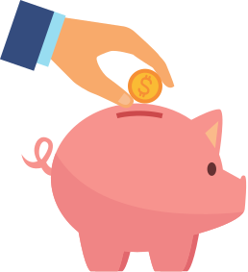
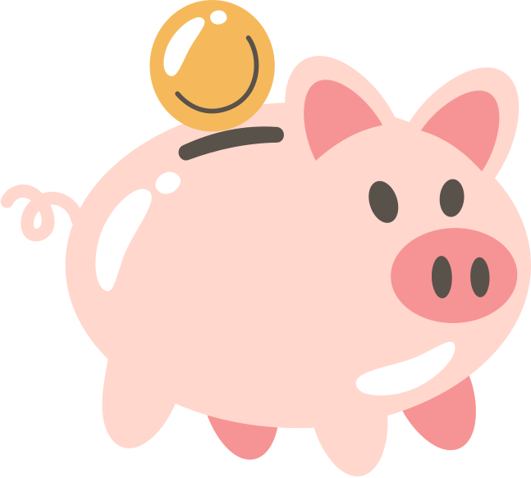

PUTTING IT ALL TOGETHER
Building the Prototype

Slide 8
PUTTING IT ALL TOGETHER
Brief Description:
The Piggy-Pon prototype was designed by drawing on paper to visualize a functional web-based savings tracker. Though not yet programmed, it allowed us and the users to see the app’s core features, flow, and interface design in a realistic, handy.
Prototype Objective:
To evaluate the usability, clarity, and motivational impact of Piggy-Pon’s interface before actual development. It aimed to test how easily users could log savings, set goals, and view their progress without needing full code implementation.

Slide 9
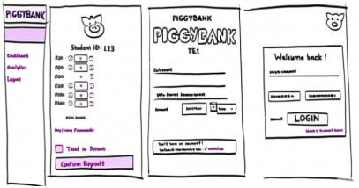
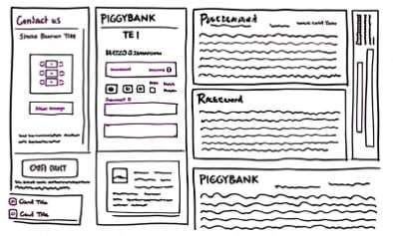
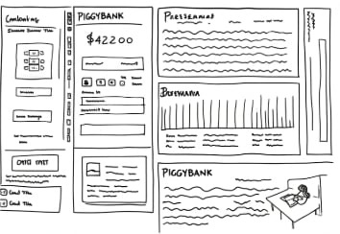
PUTTING IT ALL TOGETHER
PROTOTYPE DESIGN

Slide 10
PUTTING IT ALL TOGETHER
PROTOTYPE DESIGN
The prototype is designed to be simple, visually clear, and easy on the eyes. It is created in physical paper form, allowing participants to interact with a tangible version of the interface. This format enables unbiased evaluation, as users can focus on the layout and flow without digital distractions. The navigation is intentionally structured for easy familiarization and memorization, supporting quick learning. The prototype will be evaluated using Heuristic Evaluation, ensuring that core usability principles are properly assessed through participant feedback and expert review.
We then created the Frontend of the App

Slide 11
FEATURES
Dashboard with total savings, active goals, and quick-add button
Goal Setting screen with target amount, duration, and name
Add Savings Interface
Progress Visualization using bars and charts
Login/Signup Screens to simulate account flow

Slide 12

EVALUATION PLAN
Prepare
Launch
Evaluate
Discussion
Conclusion
The team will prepare the prototype, print materials, task scenarios, and a feedback survey. A schedule will be set based on participant availability, ensuring a smooth testing session.
During the evaluation, participants will interact with the physical prototype by performing given tasks. The paper format minimizes digital distractions and helps reduce bias by keeping users focused on layout and flow.
Team members will observe and guide participants through each task, taking notes on time, behavior, and confusion points. A Heuristic Evaluation will also be conducted to assess design consistency, clarity, and feedback.
After all sessions, the team will review the collected results, compare participant responses, and identify recurring usability themes. Feedback will be categorized into strengths and problem areas.
The team will share final insights and determine what features require refinement. Suggestions like improving icon labels, adding onboarding steps, or simplifying flow will guide the next design iteration.

Slide 13
METHODS OF EVALUATION
Heuristic Evaluation
User Testing with Task Scenarios
Post-Test Survey (Likert + Open Feedback)
Success Time Benchmarking
Conducted using Nielsen’s 10 Usability Heuristics
Evaluators will inspect the interface to check for issues related to feedback, error prevention, consistency, and user control
Helps catch early usability flaws before user testing
Participants will be given specific tasks (e.g., “Add ₱50 savings” or “Set a goal for ₱200”) using the paper prototype
Observers will note task success, time, confusion points, and navigation flow
Focus on learnability, memorability, and user satisfaction
After testing, participants will fill out a brief survey
Includes a 5-point Likert scale for evaluating ease of use, clarity, and visual appeal
Open-ended questions will collect qualitative feedback on what users liked or found confusing
Each task will be timed to compare against predefined success thresholds
Helps determine which actions feel intuitive and which need streamlining

Slide 14
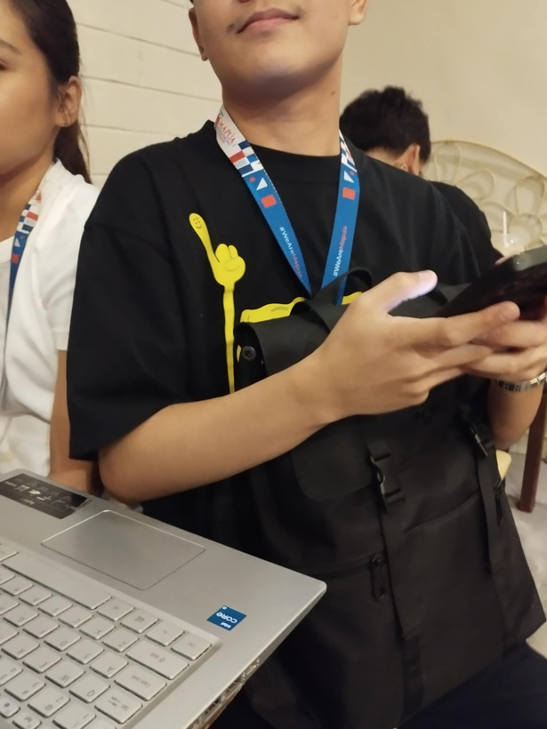
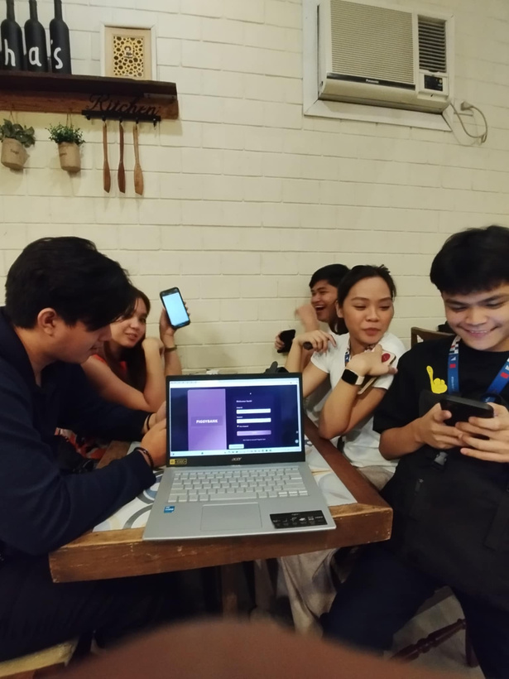
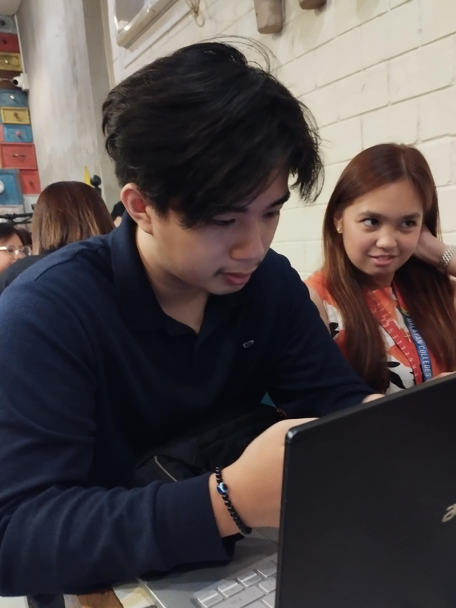
TESTING WITH PARTICIPANTS
PROTOTYPE DESIGN

Slide 15
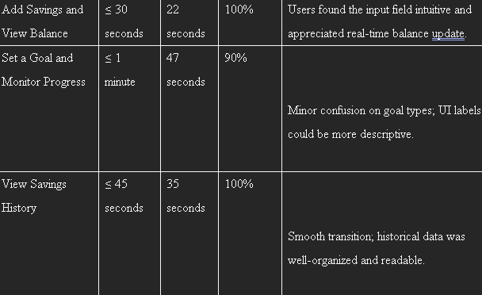
USABILITY PARTICIPANTS

Slide 16
OBSERVATIONS
Most participants completed tasks with little help, though a few paused to double-check steps.
Navigation was generally clear, but some users hesitated before selecting the right option.
Icons were mostly understood, though a few users asked for clarification on unfamiliar symbols.
Non-tech users managed well overall, needing brief reassurance on certain tasks.
Task times were within limits, but some actions took slightly longer on the first attempt.

Slide 17
HEURISTICS EVALUATION
Overall, the Piggy-Pon prototype adhered to most of Nielsen’s usability heuristics, with a clear layout, consistent visual design, and intuitive navigation. However, there were still a few criteria that need refinement.
One key area that stood out was "Help Users Recognize, Diagnose, and Recover from Errors." Since the prototype was paper-based and non-interactive, there were limited visual cues for errors or invalid inputs. Some users were unsure how the system would respond to mistakes like entering the wrong amount or accidentally deleting a goal.
Improving this aspect in future versions—such as adding clear prompts, confirmations, or undo options—would make the interface more supportive and forgiving.

Slide 18
RESULTS
With an overall average of 4.59, users are satisfied with Piggy-Pon. But there are still comments and suggestions for improvement.
Accessibility
Error Handling
Functionality
Installation
Other
Support
Usability
4.47
4.47
4.77
4.87
4.73
4.33
4.49
With suggestions like:
Improve Visual Design
Integrate Reminders and Notifications
Gamified Progress Tracker
Help Center

Slide 19
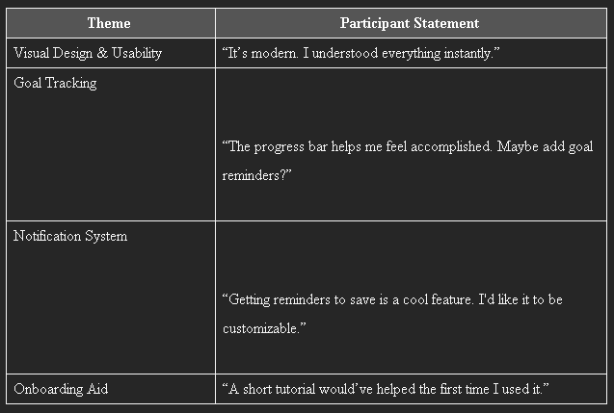
FEEDBACKS

Slide 20
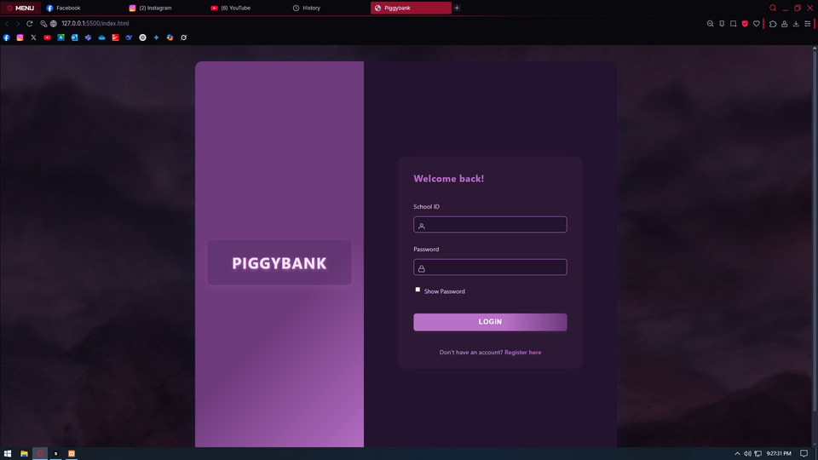
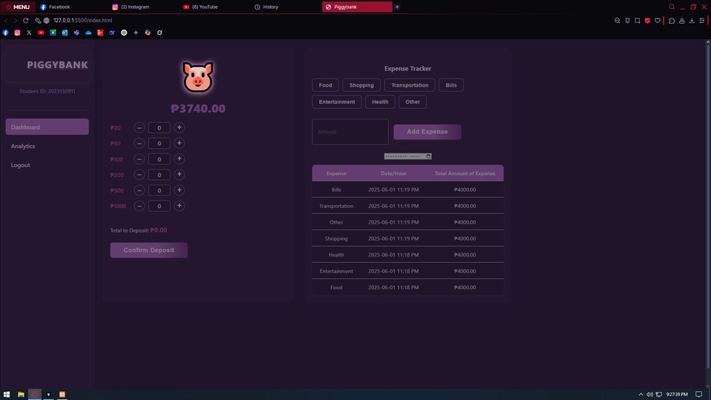
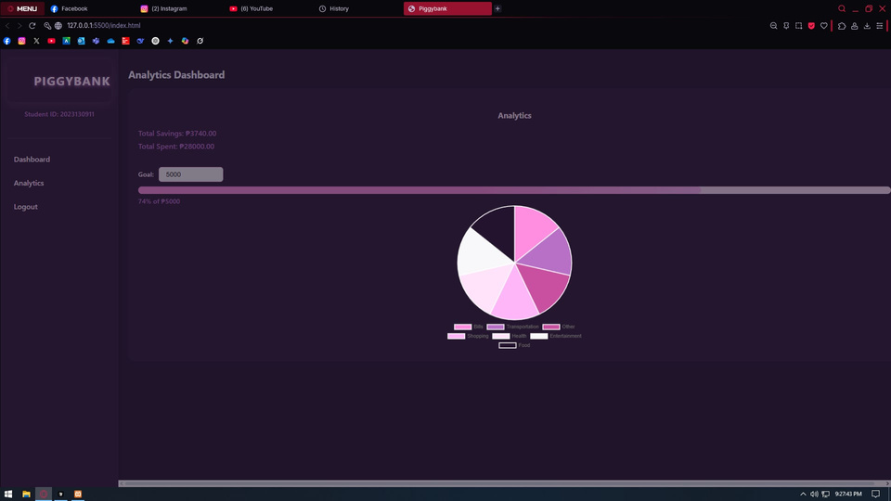
LATEST PROTOTYPE

Slide 21
CONCLUSION
Piggy-Pon taught us that applying HCI goes beyond making a working app—it’s about solving real problems in a way that feels natural and motivating.
Our prototype proved that even without full functionality, users could confidently track savings, set goals, and enjoy the experience.
We learned that thoughtful design, continuous feedback, and user empathy turn even a simple concept—like a piggybank—into something empowering.
Piggy-Pon isn’t perfect yet, but it has purpose.

Slide 22
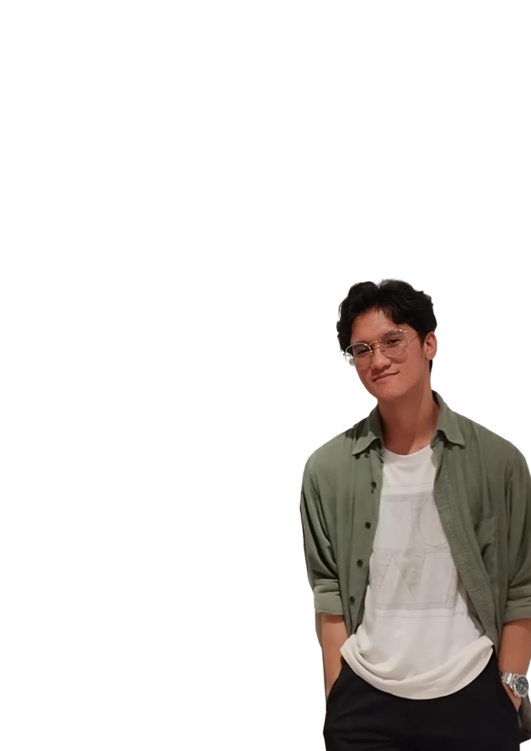
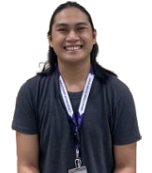
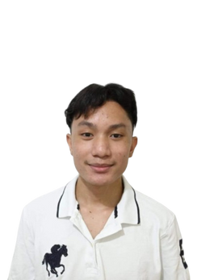
KZH MEMBERS
Zuriel Magtibay
2nd Year - CS
Harvey Quijada
4th Year - CS
Kendrick Flores
2nd Year - CS

Slide 23
THANK YOU

